Slide 1


COSC 2779 | Deep Learning Assignment 3 Topic : Deep CNN for Facial Emotion Recognition & FACS Code Detection (Improvements to Model -RestNet ) COSC 2779 | Deep Learning Assignment 1 Submitted by : Jyoti, s3880522 Detection
Notes:
Hello professor, thank you for joining me for the presentation. Today, In this video demonstration, I will do a critical analysis of work done in assignment 1 , as well as improvements/extensions that could be made based
on a literature review of the state-of-the-art approaches.
Deep Learning, a subset of Machine Learning, takes emotion recognition a step further. DL models, particularly Convolutional Neural Networks (CNNs), are designed to automatically and adaptively learn spatial hierarchies of features from the training data.
Proceeding further >

Slide 2
Notes:
Ack of country

Slide 3
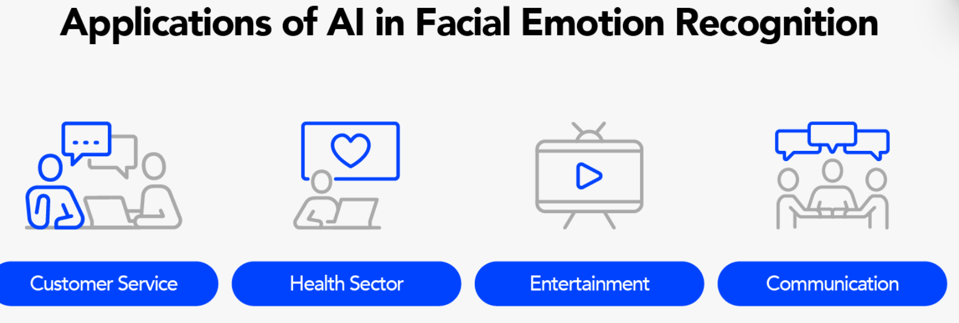
Introduction
Analysis of work done in assignment 1: Deep CNN for Facial Emotion Recognition & FACS Code Detection
Improvements/extensions that could be made based on a literature review
Notes:
Agenda of this demo is - An overview of the work completed in Assessment 1, along with potential enhancements and extensions informed by a literature review of cutting-edge methodologies and advanced techniques acquired during the course.
Introduction:
Facial expression analysis is a crucial task in computer vision and machine learning, with applications ranging from security and human-computer interaction to driver safety and healthcare.
If we talk about definition of facial emotion recognition : FER is an advanced application of artificial intelligence that focuses on detecting and interpreting human emotions from facial expressions. Using principles from both computer vision and machine learning, FER systems are able to identify the key features of a face such as the eyes, eyebrows, nose, and mouth, and analyze the spatial arrangement and movement of these features to classify a person's emotional state.
Use of facial emotion recognition in customer service and marketing
Facial emotion recognition technology has proven to be a game-changer in customer service and marketing, leading to more personalized and engaging experiences.

Slide 4

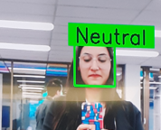
A brief description of the problem.
source
Notes:
In my assignment 1, I aim to develop an end-to-end trained deep convolutional neural network (CNN) to identify high-level emotions (Positive, Negative, Surprised) and detect specific Facial Action Coding System (FACS) codes in images. We will use a subset of The Extended Cohn-Kanade Dataset (CK+) to accomplish this task.
Dataset Description:
The CK+ dataset comprises 560 labeled images collected from 123 subjects. These images are annotated with high-level emotions and FACS codes, making it a valuable resource for emotion recognition research. The dataset is described in detail in the linked paper.
Objective:
Our primary objective is to design a comprehensive experiment to predict two key attributes:
High-Level Emotion: We aim to classify images into one of three emotions - "Positive," "Negative," or "Surprised."
FACS Codes: We aim to determine if a specific FACS code is present in each image. This is a binary classification task, where we predict whether a particular FACS code is expressed in the image (yes/1) or not (no/0)

Slide 5
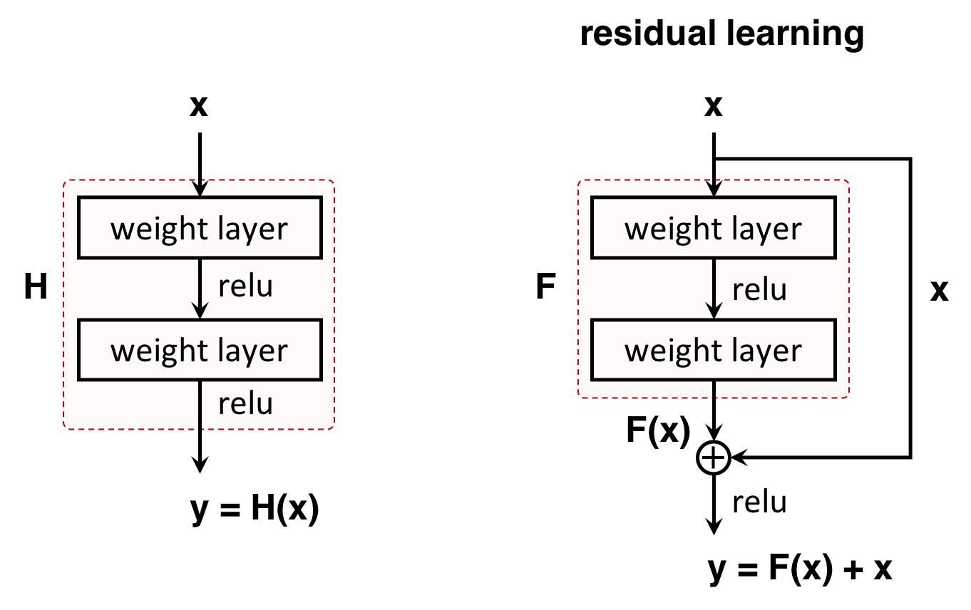
The key elements of solution
Data Analysis & Preprocessing
Exploration of Extended Cohn-Kanade (CK+) Dataset & Data Preprocessing
Image Visualization and Data Description
Action Units Analysis & Correlation
Data Splitting
Data Loader
Data Augmentation
Baseline model [ResNet Model]
Hyper parameters selection strategy:
Model Compilation
Model evaluation
Notes:
First I did exploration of Extended Cohn-Kanade (CK+) Dataset & Data Preprocessing to get insights in data.
Next, Image Visualization and Data Description: Images are displayed using PIL and Matplotlib to visually inspect a subset of the dataset
Action Units Analysis & Correlation: I observed that three unique emotions are present: 'negative,''surprise,' and 'positive.' The dataset includes rows with specific emotions and associated Action Units (AU) values , I did visualization after it .
Data Splitting: I split CK dataset into three subsets: training, validation, test sets. The training set consists of 60% of original dataset. The validation set and test each make up 20% of original dataset.
I created my customized Data Loader: I have defined a DataGenerator class to prepare batches of image data with associated labels
for training deep learning models. I have added 2 output layers, one to predict emotions, 2nd to predict FACS.
Data Augmentation is applied in data loader. I did Random Rotation, Random Shift, Padding, Brightness Adjustment as part of augmentation.
Finally, the image is cropped to match the desired input size after all other augmentations
Baseline model [ResNet Model]
I chose ResNet model for facial emotion recognition and FACS label due to its ability to handle deep architectures,
extract meaningful features, leverage pre-trained models, and achieve state-of-the-art performance.
Architecture: My model consists of an input layer, convolutional layers, 12 residual blocks with varying
numbers of convolutional layers and filter sizes, a global average pooling layer, a flattened layer.
Residual Blocks (Total of 12 Blocks): Each block includes multiple Conv2D layers with 64 filters, kernel size (3x3), and ReLU activation.
Batch Normalization is applied within each residual block.
Hyper parameters selection strategy: I have used Regularization lambda and changed with no of epcohs.
I have used Adam optimizer,
Two different loss functions for emotion output (categorical_crossentropy) and the FACS output (binary_crossentropy). In addition to it, I used F1 score metrics for both tasks along with accuracy.
The last part was model compilation and performance evaluation.
Other than it , I used Mobile Net as well to explore this problem as MobileNet is a strong choice for emotion recognition in mobile applications due to its efficiency, speed, low memory footprint, and the ability to achieve satisfactory accuracy.

Slide 6
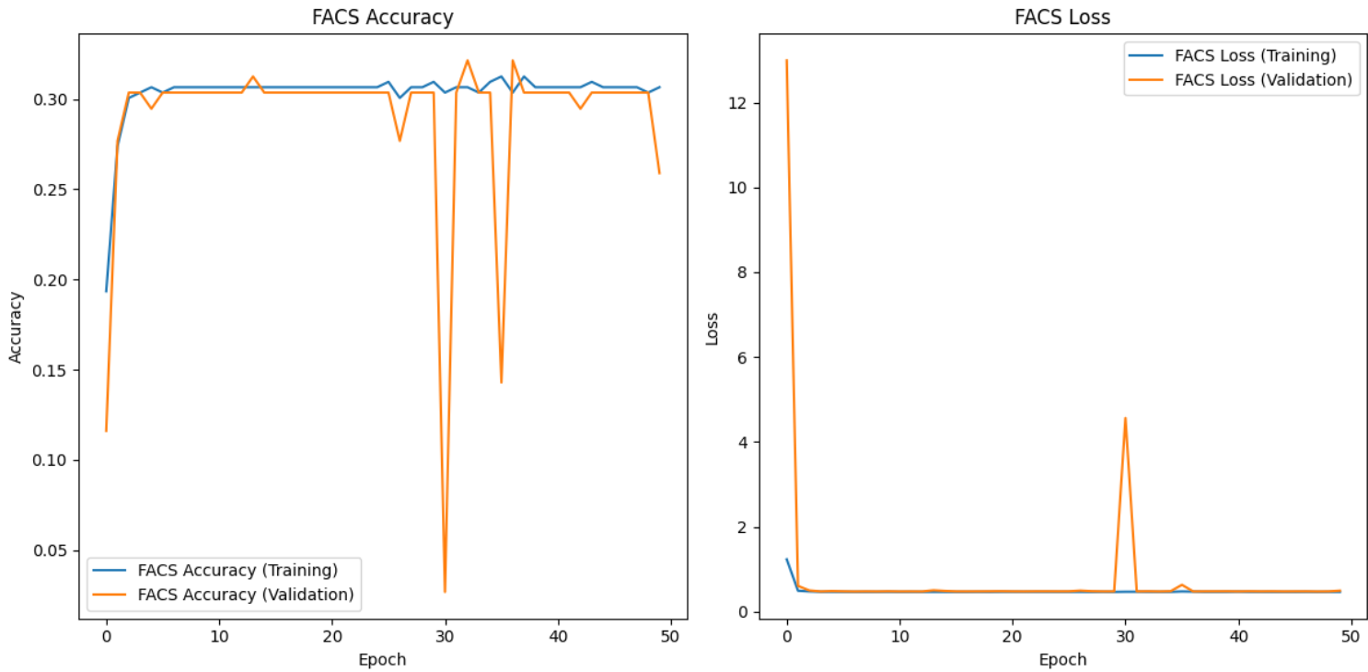
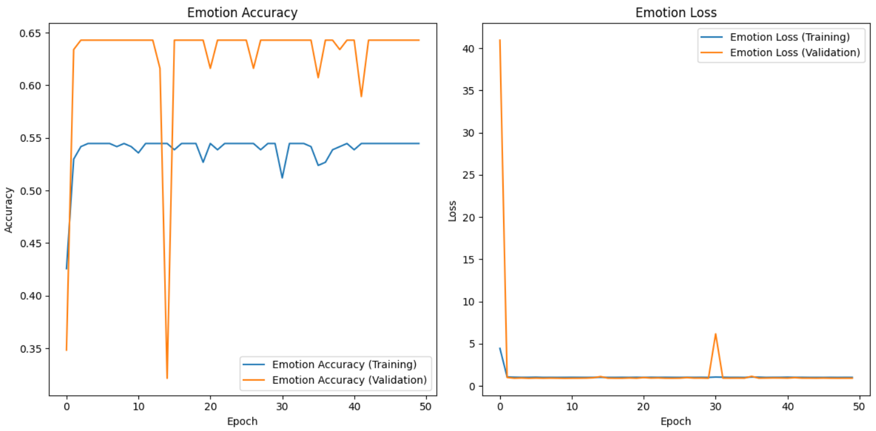
Summary performance & Comparison to baseline
Notes:
During Heatmap visualization, it is observed that there are Strong positive correlations are found between AUs 1 and 2, AUs 1 and 27, AUs 2 and 27, AUs 6 and 12, and AUs 23 and 24. Strong negative correlations are observed between AUs 11 and 26, and AUs 14 and 15.
Ultimate judgment: Run 1 and Run 4 strike a balance between overfitting and underfitting, showcasing the importance of careful hyperparameter selection for achieving good model performance. Run 3 overfits the data, while Run 2 underfits.
Accuracy & F 1 score Metrics For emotion prediction: The precision score of 0.7656 indicates that when the model predicts an emotion, it is correct approximately 76.56% of the time. The recall score of 0.625 suggests that the model captures approximately 62.5% of all actual positive emotions.
The F1 score of 0.4808 is the harmonic mean of precision and recall, providing a balance between the two.
Accuracy & F 1 score Metrics For FACS label detection: The weighted FACS label precision score of 0.9778 indicates that when the model predicts FACS labels, it is correct approximately 97.78% of the time.
Adjusting hyperparameters can significantly impact a model's performance and reduced losses
No. of epcohs also palyed a mojor role. Any epoch less than 10 was not training model well at all.
A lower regularization lambda of 0.0001 resulted in the best overall performance in terms of emotion accuracy and competitive FACS label accuracy. A higher regularization lambda of 0.1 led to lower emotion accuracy.
A very low regularization lambda of 0.00001 performed reasonably
In conclusion, the emotion prediction model demonstrates reasonably good performance
However, there is room for improvement in predicting emotions, as the F1 score could be higher. On the other hand, the FACS label detection model shows high precision but relatively low recall, which suggests that it tends to make accurate predictions for FACS labels but may miss some of them.
Further optimization may be required to improve recall without sacrificing precision in FACS label detection.
Overall, the model's performance can be considered promising but with potential for further refinement and optimization, especially in the context of both emotion prediction and FACS label detection

Slide 7

The approach is adequate to solve the problem ?
Mitigating Model Limitations
Transfer Learning and Fine-Tuning
Experimenting with Model Architectures
Enhancing Data Quality
Balancing Data and Class Imbalance
Resource Optimization
Notes:
The approach is adequate but there is very high loss, Data Imbalance, Limited Generalization, Model Complexity, Interpretable Features as black box, Resource Requirements, Robustness to Noisy Data, Ethnic and Gender Bias, Limited Data for FACS Labels.
To mitigate some of ResNet model limitations, I can explore techniques such as transfer learning, fine-tuning on larger and more diverse datasets, and experimenting with different model architectures like MobileVnet.
Additionally, addressing data quality and balance issues will be critical for improving the robustness and accuracy.
Mitigating Model Limitations:
We acknowledge various limitations of the ResNet model, including high loss, data imbalance, and limited generalization. Our approach is centered on addressing these challenges effectively.
Transfer Learning and Fine-Tuning:
Leveraging transfer learning and fine-tuning techniques allows us to capitalize on pre-trained models' knowledge. This empowers our model to learn from larger and more diverse datasets, reducing the impact of limited training data.
Experimenting with Model Architectures:
By exploring different model architectures like MobileNet, we cater to the need for model efficiency and resource optimization, making our approach well-suited for real-world applications.
Enhancing Data Quality:
Robustness to noisy data and mitigation of ethnic and gender biases are pivotal aspects of our strategy. These efforts contribute to data quality, making our approach more reliable and unbiased.
Balancing Data and Class Imbalance:
Dealing with data imbalance and class imbalance issues ensures fairness and accuracy in our predictions. This approach addresses the model's limitations and enhances its suitability for diverse use cases.
Resource Optimization:
The need for reduced resource requirements is acknowledged. We aim to create models that are not only accurate but also efficient, making them practical for resource-constrained environment

Slide 8

Literature Review This presentation provides an overview of the latest research in facial emotion recognition. It discusses the various techniques and algorithms used in this field and highlights the advancements made in recent years.

Slide 9
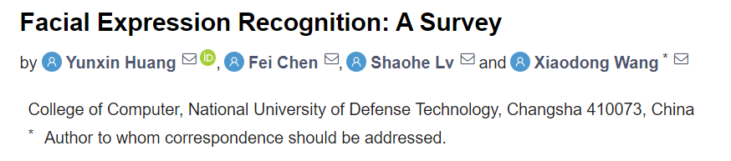
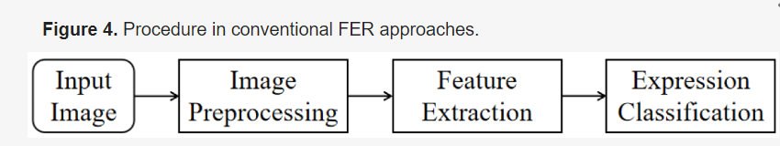
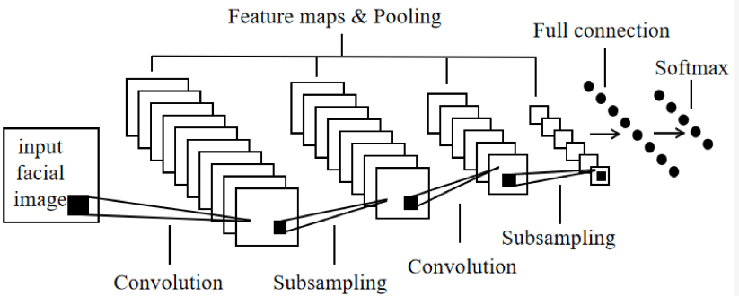
Paper 1 https://www.mdpi.com/2073-8994/11/10/1189
Notes:
Facial Expression Recognition (FER) has attracted increasing attention in recent years. The past decade has witnessed the development of many new FER algorithms
In order to take advantage of temporal features for recognising facial expression, a new integration method named Deep Temporal Appearance-Geometry Network (DTAGN) is proposed in paper. The Deep Temporal Appearance Network (DTAN) extracts appearance features from image sequences. The Deep Temporal Geometry Network (DTGN) extracts geometry features from temporal FL points. The the joint DTAGN boost the performance of the FER by making full use of temporal information Deep Belief Network (DBN).
The DBN is based on Restricted Boltzmann Machine (RBM) and its feature extraction of input signal is unsupervised and abstract. The FER method based on DBN can learn the abstract information of facial images automatically and is susceptible to activity factors. Combined with other components, DBN has proved to be an effective FER approach
Conclusion :
Deep learning-based FER approaches highly reduce the reliance on image preprocessing and feature extraction and are more robust to environments with different elements.
Long Short-Term Memory (LSTM)
An RNN composed of LSTM units is commonly referred to as an LSTM network, which is well suited for the temporal features extraction of consecutive frames. Based on previous studies, long-range context modelling helps improve the accuracy of emotion analysis, some LSTM-based FER approaches on video sequence are proposed.

Slide 10
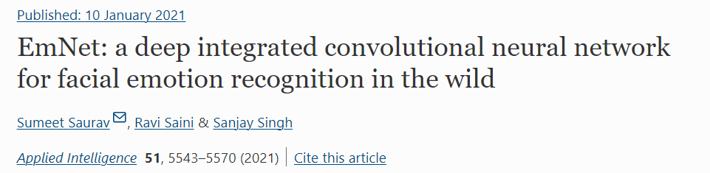
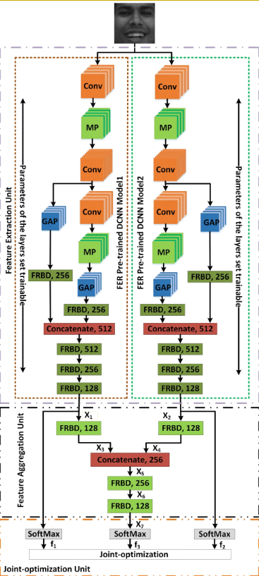
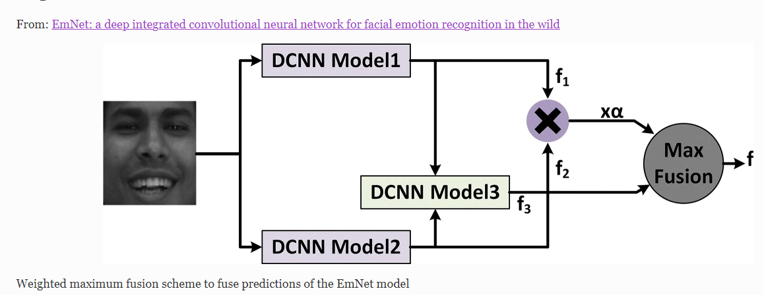
Paper 2 https://link.springer.com/article/10.1007/s10489-020-02125-0
Notes:
In this paper, the presented a robust and computationally efficient pipeline for the automatic recognition of facial emotions in the wild in real-time on a resource-constrained embedded platform. The proposed FER pipeline has employed a novel deep integrated CNN model named EmNet (emotion network) that jointly optimizes two structurally similar DCNN models and their integrated variant. The two DCNN models extract complementary information from the facial images and thus helped the integrated DCNN model and the complete EmNet model to achieve enhanced performance.
Figure 3 shows the structure of the proposed EmNet (emotion network), a jointly-optimized DCNN model for FER in the wild. The EmNet model is a single-input and multi-output model, which for every facial image provides three predictions corresponding to the DCNN Model1, DCNN Model2, and their integrated variant named DCNN Model3. Therefore, during inference, these predictions are fused using the weighted maximum or average fusion to obtain the final decision of the EmNet model.

Slide 11
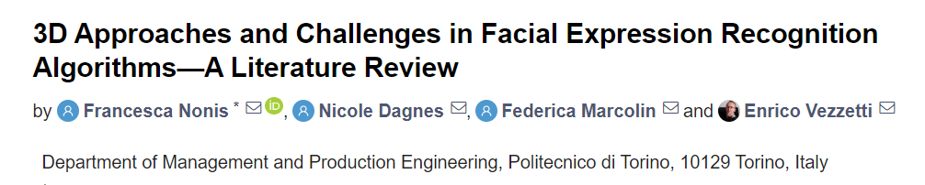
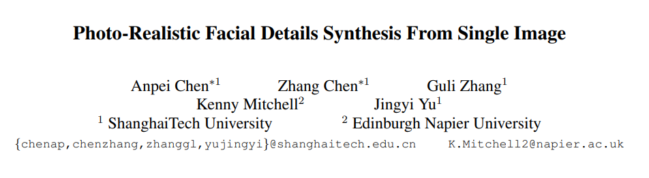
Paper 3 , 4
Notes:
Paper 3rd : The overall recognition accuracy of the expressions is included in a range between 60% and 90%. Some expressions, like anger and fear, generally have the lowest recognition rates. Indeed, the motions of these expressions are moderate compared to happiness or surprise, and thus more challenging to recognize. Regarding the action units, the experiments reached recognition rates in a broader range, between 50% and 95%. The number of features for each AU to be detected will be increased to achieve more accurate results.
Paper 4th: It presented a single-image 3D face synthesis technique that can handle challenging facial expressions while preserving fine geometric structures. technique combines cues provided by emotion, expression, appearance, and lighting for producing high fidelity proxy geometry and fine geometric details. For detail synthesis, our Deep Facial Detail Net (DFDN) employs both geometry and appearance loss functions and is trained on real data both captured by our system and from in-the-wild images. Comprehensive experiments have shown that our technique can produce, from a single image, ultra high quality 3D faces with fine geometric details under various expressions and lighting conditions.
In a nutshell, these papers provide insights into recognition accuracy, challenging expressions, 3D face synthesis, and multidimensional cues, all of which can contribute to the advancement of FACS and emotion detection techniques by enhancing accuracy and capturing fine details in facial expressions

Slide 12

Advanced techniques
Unsupervised learning including generative models
Self-Supervised Learning techniques
Notes:
Assumptions for Self-Supervised Learning techniques
Existence of a large unlabeled dataset for self-supervised learning.
Availability of a small labeled dataset for fine-tuning.
The proxy tasks are designed to capture features relevant to emotion recognition and FACS coding.
The base model can be pretrained effectively on the chosen proxy tasks

Slide 13
Advanced techniques Self-Supervised Learning techniques
Design
Design a Proxy Task
Proxy Task for Emotion and FACS Detection
Train
Train a Base Model on the Proxy Task
Base Model Training
Transfer
Transfer Learning with Small Labeled Dataset
Fine-Tuning on Small Labeled Dataset
Benefits : Data Efficiency Feature Learning , Reduced Risk of Overfitting , Potential for Fine-Tuning
Notes:
The approach described, where a proxy task is used for self-supervised learning before fine-tuning on a small labeled dataset, can be applied to enhance your ResNet model for emotion and FACS detection when you have limited labeled data. Here's how it can be implemented:
Step 1: Design a Proxy Task
Proxy Task for Emotion and FACS Detection: Instead of manually labeling emotions and FACS codes, design a proxy task that doesn't require manual annotations. For emotion recognition, you can create a task that involves reconstructing parts of facial expressions. For FACS coding, design a proxy task that involves predicting missing facial features or actions.
Step 2: Train a Base Model on the Proxy Task
Base Model Training: Train a base ResNet model on the proxy task using a large dataset. In this case, the proxy task could be related to facial expression reconstruction or predicting missing features.
Step 3: Transfer Learning with Small Labeled Dataset
Fine-Tuning on Small Labeled Dataset: After the base model is trained on the proxy task, fine-tune it on your small labeled dataset for emotion and FACS detection.
Use the features learned during proxy task training as a starting point for your emotion and FACS detection model.
Fine-tuning with the small labeled dataset helps the model adapt to the specific tasks of emotion recognition and FACS coding.
Improved Feature Learning: By training the base ResNet model on a self-supervised proxy task, you can expect the model to learn meaningful and robust features related to the structure of facial expressions and actions.
Better Generalization: The features learned during the proxy task are expected to be transferable to the tasks of emotion and FACS detection. This should lead to better generalization to new, unseen data.
Data Efficiency: Using this approach, you can achieve competitive performance with a smaller labeled dataset, which is particularly valuable when there's a limited amount of labeled data available.
Reduced Risk of Overfitting: Pretraining on a proxy task can help mitigate the risk of overfitting to the small labeled dataset, as the model starts with useful feature representations.
Potential for Fine-Tuning: Depending on the specifics of your small labeled dataset, fine-tuning the pre-trained model should result in further improvements in emotion and FACS detection accuracy

Slide 14
Advanced techniques Unsupervised learning including generative models
1. Autoencoders:
Data Augmentation: Train autoencoders to generate augmented facial expression data for improved model generalization.
Feature Extraction: Utilize autoencoders to extract meaningful features from images to enhance model performance.
2. Generative Adversarial Networks (GANs):
Data Augmentation: GANs create synthetic data to augment training sets, increasing the diversity of emotions and expressions.
Fine-Tuning: Pretrain GANs on large expression datasets and fine-tune them for our specific tasks to transfer knowledge of generating realistic expressions.
3. Text Generation:
Emotion Labeling: Generate textual labels for images, describing emotions or FACS codes, and supplement training data with these descriptions to aid in model training.
4. Speech Generation:
Multimodal Learning: Use speech generation to create audio clips corresponding to emotions in images, enabling the model to learn from both visual and auditory cues.
Notes:
1. Autoencoders:
Data Augmentation: Train autoencoders to generate augmented facial expression data for improved model generalization.
Feature Extraction: Utilize autoencoders to extract meaningful features from images to enhance model performance.
2. Generative Adversarial Networks (GANs):
Data Augmentation: GANs create synthetic data to augment training sets, increasing the diversity of emotions and expressions.
Fine-Tuning: Pretrain GANs on large expression datasets and fine-tune them for our specific tasks to transfer knowledge of generating realistic expressions.
3. Text Generation:
Emotion Labeling: Generate textual labels for images, describing emotions or FACS codes, and supplement training data with these descriptions to aid in model training.
4. Speech Generation:
Multimodal Learning: Use speech generation to create audio clips corresponding to emotions in images, enabling the model to learn from both visual and auditory cues.

Slide 15
Advanced techniques – other techniques
Clustering for Feature Grouping
Literature Reference: "Cluster Analysis" by Everitt, B. S., Landau, S., Leese, M., & Stahl, D. (2011). This book provides a comprehensive overview of clustering techniques
Anomaly Detection for Data Quality
Literature Reference: "Anomaly Detection: A Survey" by Chandola, V., Banerjee, A., & Kumar, V. (2009). This survey paper discusses various anomaly detection techniques
Notes:
Clustering for Feature Grouping:
Use unsupervised clustering techniques such as K-means or hierarchical clustering to identify common patterns or clusters of facial expressions and actions.
This can help group similar expressions and actions, aiding your ResNet model in recognizing specific emotions and FACS codes.
Literature Reference: "Cluster Analysis" by Everitt, B. S., Landau, S., Leese, M., & Stahl, D. (2011). This book provides a comprehensive overview of clustering techniques.
Anomaly Detection for Data Quality:
Employ unsupervised anomaly detection methods to identify and handle outliers or low-quality data points.
Ensuring data quality is essential for accurate FACS coding and emotion recognition.
Literature Reference: "Anomaly Detection: A Survey" by Chandola, V., Banerjee, A., & Kumar, V. (2009). This survey paper discusses various anomaly detection techniques

Slide 16
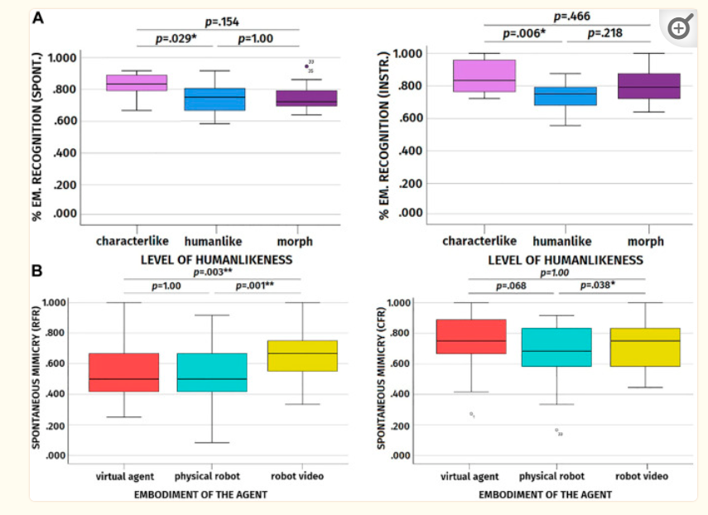
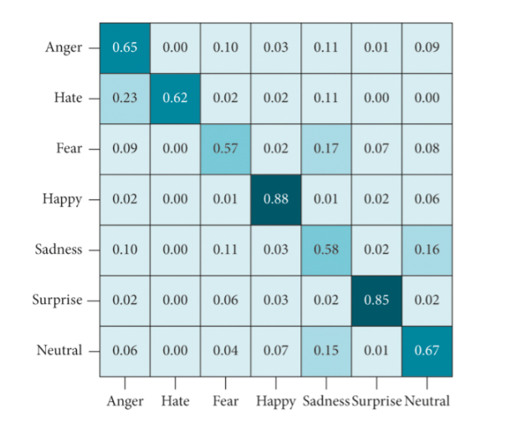
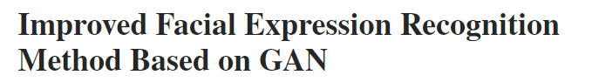
Results Analysis
GAN : src
Proxy Model : src
Notes:
GAN : shows that the method performs well in identifying “happy” and “surprised,” with accuracy rates reaching 88% and 85%, respectively. In addition, it can be noticed that the ability to recognize “fear” facial expressions of generating confrontation network is low, with an accuracy rate of 57%. This is because the labeling in the FER 2013 dataset is not good.
Proxy task : Facial Mimicry Towards Artificial Agents
According to the results, participants’ emotion recognition was better when participants observed the characterlike agents with respect to when they observed the humanlike agents

Slide 17
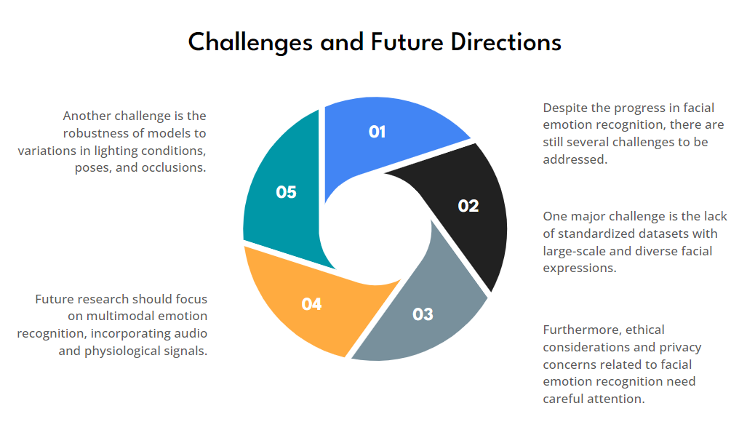

Slide 18
References
neural networks (IEEE world congress on computational intelligence) (pp. 1322-1328). https://www.mdpi.com/2073-8994/11/10/1189
https://www.hindawi.com/journals/sp/2021/2689029/
https://www.ncbi.nlm.nih.gov/pmc/articles/PMC8635490/
https://www.mdpi.com/2076-3417/9/18/3904
https://openaccess.thecvf.com/content_ICCV_2019/papers/Chen_Photo-Realistic_Facial_Details_Synthesis_From_Single_Image_ICCV_2019_paper.pdf
https://www.mdpi.com/2076-3417/9/18/3904

Slide 19

Thank you…..........

